Slide 1
<DATA STRUCTURES AND ALGORITHM>

Slide 2
VII. QUEUE

Slide 3
QUEUE
A queue is a data structure used for storing data (similar to Linked Lists and Stacks). In queue, the order in which data arrives is important. In general, a queue is a line of people or things waiting to be served in sequential order starting at the beginning of the line or sequence.
A queue is an ordered list in which insertions are done at one end (rear) and deletions are done at other end (front). The first element to be inserted is the first one to be deleted. Hence, it is called First in First out (FIFO) or Last in Last out (LILO) list.

Slide 4
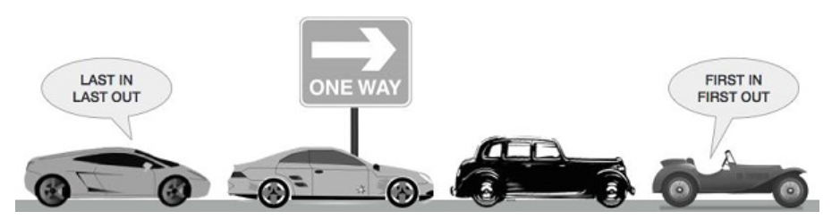
EXAMPLE OF QUEUE
A real-world example of queue can be a single-lane one-way road, where the vehicle enters first, exits first. More real-world examples can be seen as queues at the ticket windows and bus-stops.

Slide 5
MAINLY OPERATIONS ON QUEUES
Similar to Stacks, special names are given to the two changes that can be made to a queue. When an element is inserted in a queue, the concept is called EnQueue, and when an element is removed from the queue, the concept is called DeQueue.
DeQueueing an empty queue is called underflow and EnQueuing an element in a full queue is called overflow. Generally, we treat them as exceptions.

Slide 6
MAINLY OPERATIONS ON QUEUES
enqueue() − add (store) an item to the queue.
dequeue() − remove (access) an item from the queue.
peek() − Gets the element at the front of the queue without removing it.
isfull() − Checks if the queue is full.
isempty() − Checks if the queue is empty.

Slide 7
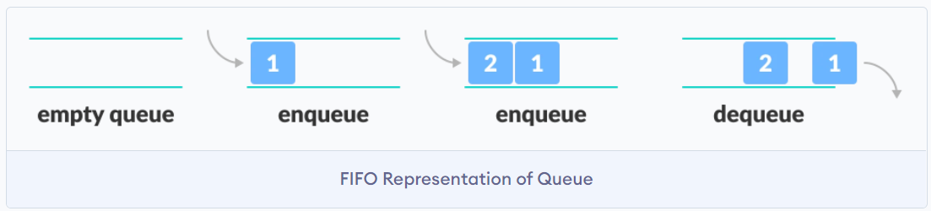
MAINLY OPERATIONS ON QUEUES

Slide 8
TIME COMPLEXITIES OF OPERATIONS ON QUEUES
enqueue(), dequeue(), isEmpty(), isFull() and peek() all take O(1) time. We do not run any loop in any of these operations.

Slide 9
APPLICATIONS OF QUEUE
• Operating systems schedule jobs (with equal priority) in the order of arrival (e.g., a print queue).
• Simulation of real-world queues such as lines at a ticket counter or any other first come first-served scenario requires a queue.
• Asynchronous data transfer (file IO, pipes, sockets).
• Waiting times of customers at call center.

Slide 10
WORKING OF QUEUE
Queue operations work as follows:
two pointers FRONT and REAR
FRONT track the first element of the queue
REAR track the last element of the queue
initially, set value of FRONT and REAR to -1

Slide 11
ENQUEUE OPERATION
Check if the queue is full
For the first element, set the value of FRONT to 0
Increase the REAR index by 1
Add the new element in the position pointed to by REAR

Slide 12
DEQUEUE OPERATION
Check if the queue is empty
Return the value pointed by FRONT
Increase the FRONT index by 1
For the last element, reset the values of FRONT and REAR to -1

Slide 13
IMPLEMENTATION OF QUEUE
There are two ways to implement a queue:
Using array
Using linked list

Slide 14
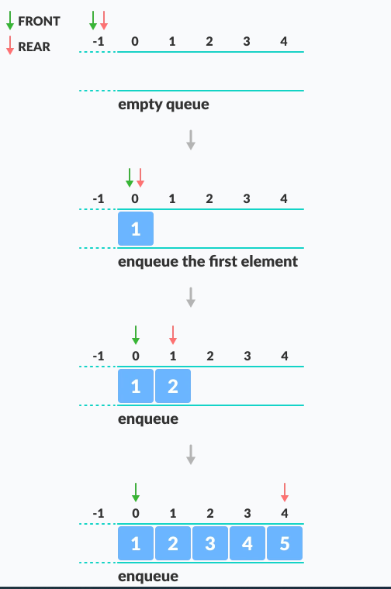
OPERATIONS ON QUEUE

Slide 15
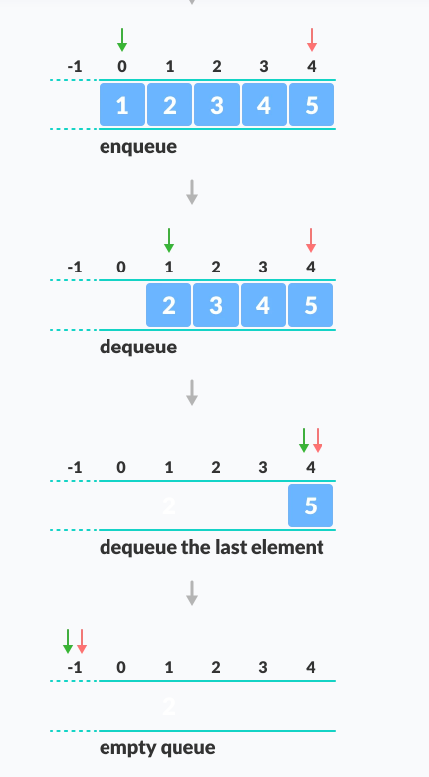
OPERATIONS ON QUEUE

Slide 16
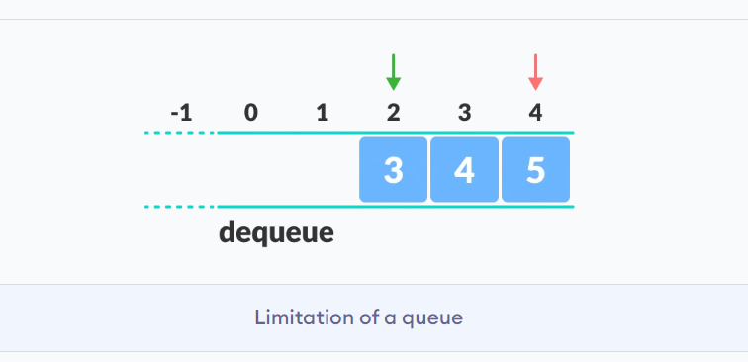
LIMITATION OF QUEUE USING ARRAY

Slide 17
LIMITATION OF QUEUE USING ARRAY
As you can see in the image above, after a bit of enqueuing and dequeuing, the size of the queue has been reduced.
And we can only add indexes 0 and 1 only when the queue is reset (when all the elements have been dequeued).
After REAR reaches the last index, if we can store extra elements in the empty spaces (0 and 1), we can make use of the empty spaces. This is implemented by a modified queue called the circular queue.

Slide 18
isfull()
bool isfull() {
if(rear == MAXSIZE - 1)
return true;
else
return false;
}

Slide 19
isempty()
bool isempty() {
if(front == -1)
return true;
else
return false;
}

Slide 20
ENQUEUE
Step 1 − Check if the queue is full.
Step 2 − If the queue is full, produce overflow error and exit.
Step 3 − If the queue is not full, increment rear pointer to point the next empty space.
Step 4 − Add data element to the queue location, where the rear is pointing.
Step 5 − return success.

Slide 21
ENQUEUE
int enqueue(int data)
if(isfull())
return 0;
rear = rear + 1;
queue[rear] = data;
return 1;
end procedure

Slide 22
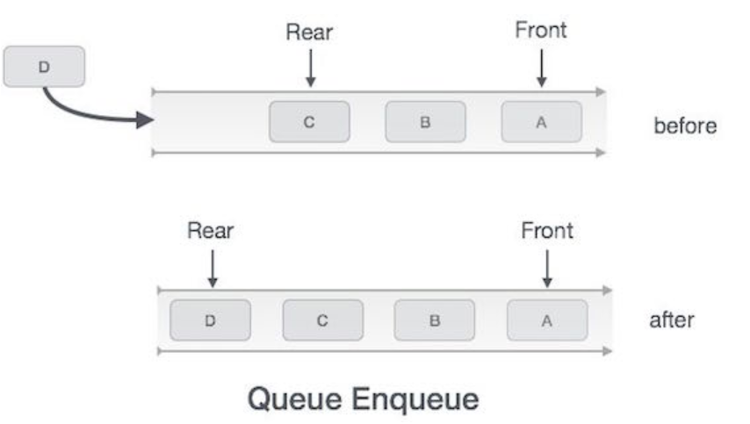
ENQUEUE

Slide 23
DEQUEUE
Step 1 − Check if the queue is empty.
Step 2 − If the queue is empty, produce underflow error and exit.
Step 3 − If the queue is not empty, access the data where front is pointing.
Step 4 − Increment front pointer to point to the next available data element.
Step 5 − Return success.

Slide 24
DEQUEUE
int dequeue() {
if(isempty())
return 0;
int data = queue[front];
front = front + 1;
return data;
}

Slide 25
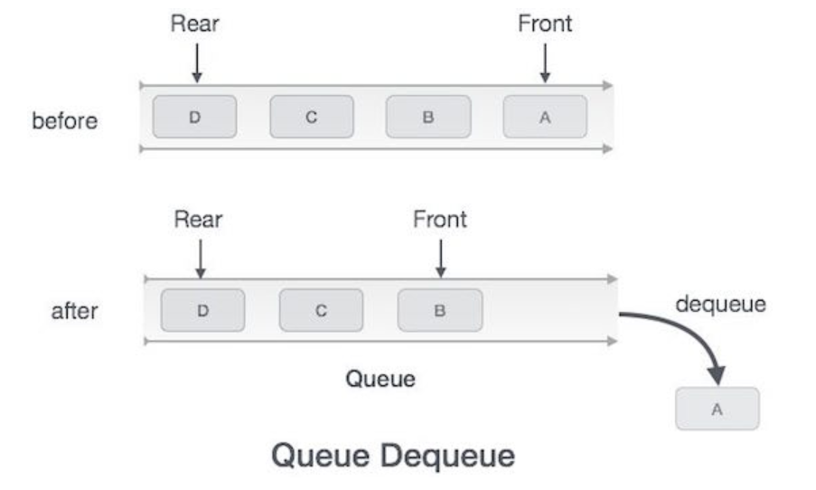
DEQUEUE

Slide 26
IMPLEMENTATION OF QUEUE
Queue using array(queuearray.c)
Queue using linked list(queuelinkedlist.c)

Slide 27
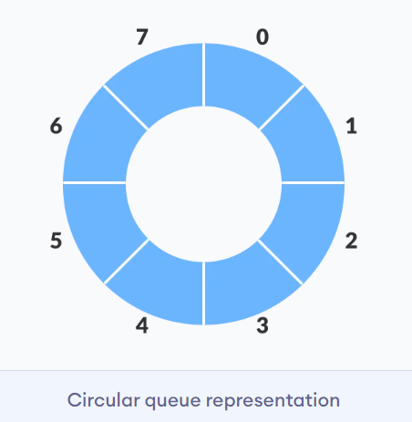
CIRCULAR QUEUE
A circular queue is the extended version of a regular queue where the last element is connected to the first element. Thus forming a circle-like structure.

Slide 28
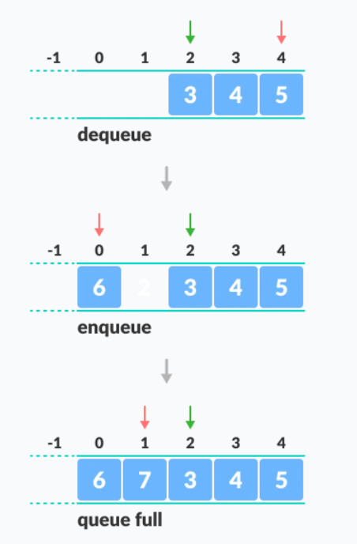
CIRCULAR QUEUE
It will fix the limitation we had in regular queue.

Slide 29
PRIORITY QUEUE
A priority queue is a special type of queue in which each element is associated with a priority value. And, elements are served on the basis of their priority. That is, higher priority elements are served first.
However, if elements with the same priority occur, they are served according to their order in the queue.

Slide 30
PRIORITY QUEUE
So, a priority Queue is an extension of the queue with the following properties:
Every item has a priority associated with it.
An element with high priority is dequeued before an element with low priority.
If two elements have the same priority, they are served according to their order in the queue.

Slide 31
REFERENCES
Data Structures And Algorithms Made Easy: Data Structures And Algorithmic Puzzles by Narasimha Karumanchi
https://www.programiz.com/
https://www.geeksforgeeks.org/
https://www.tutorialspoint.com/

